Slide 1
Predicting whether the customers coming back within 30 days and how much he/she would spend

Slide 2

Agenda
Before doing any feature selection ;
This is a multitask problem!
So the first step is a classification problem and Next is regression problem to predict how much those people would spend
EDA
Pre-processing
Feature Selection
Modeling
Model evaluation
Notes:
The detail about this project

Slide 3
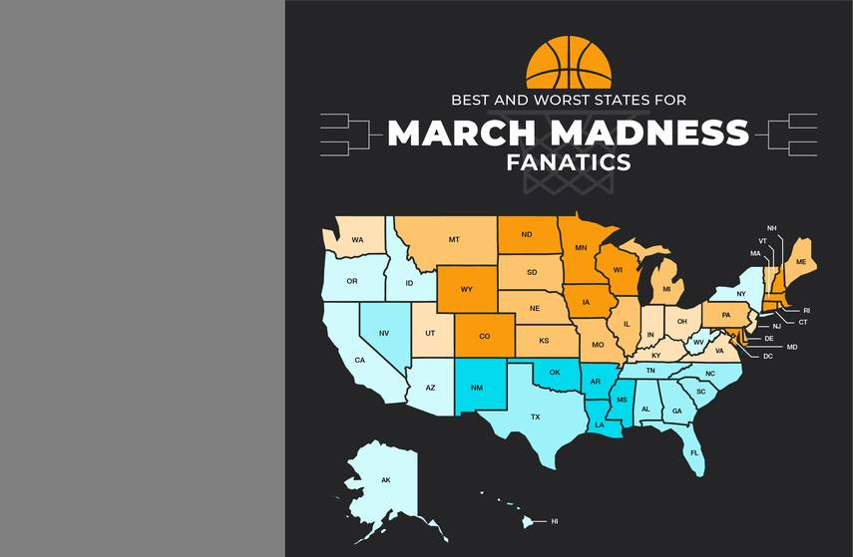
EDA
Before doing any feature selection we performed exploratory data analysis, for better understanding about the data and handled missing values and encoded categories feature.

Slide 4


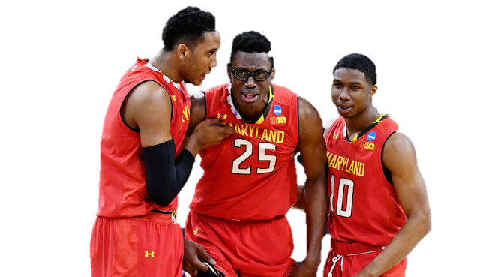
About New data
Historical data of NCAA teams:
New Variables:
Team rank
Team point
OSRS, DSRS, SRS, Ortg index scores
Notes:
Before doing any feature selection we performed exploratory data analysis where we did

Slide 5
Other preprocessing steps
Distance to Host site
We assume that
As the travel distance increases, players would be more tired and could not play well in games.
Formulas
Team1_dis =( (host_lat – team1_lat)**2 + (host_long – team1_long)**2)**0.5
Team2_dis =( (host_lat – team2_lat)**2 + (host_long – team2_long)**2)**0.5
Notes:
1 others

Slide 6
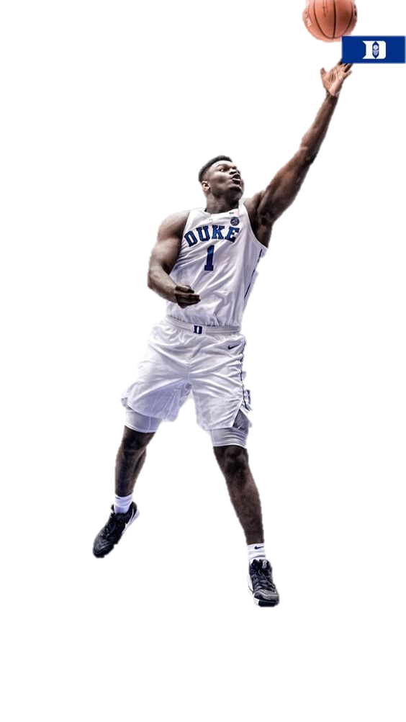
Feature Selection
PCA,
Filter & wrapper!!!

Slide 7
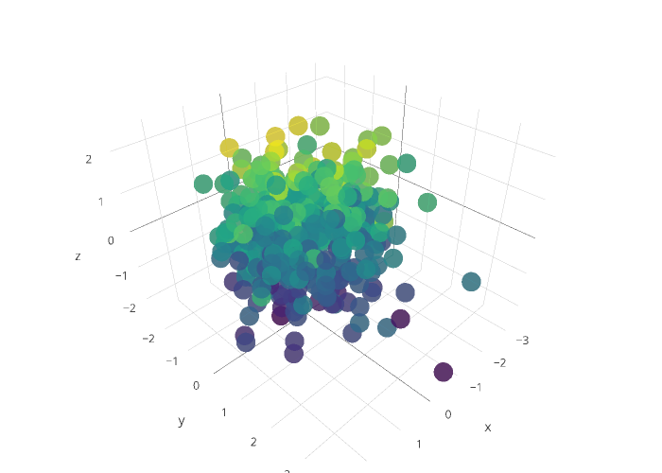
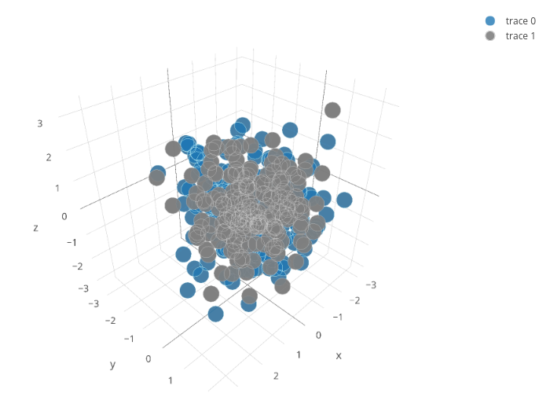
PCA and ICA Results
By using Dimension reduction for features selection
Notes:
The detail about this project

Slide 8
Feature Selection
In Filter we get 58 combinations of features
(Corr, Chi2, Mutual Information, Avg of three and Avg of rank)
And in filter, we only pick 25 features for model building
In Forward wrapper we get 60 combinations of features for each model
Notes:
Filter score and wrapper score

Slide 9
modeling
Hypertuning 7 different models,
Finding the best parameters
Notes:
Jame~~~

Slide 10
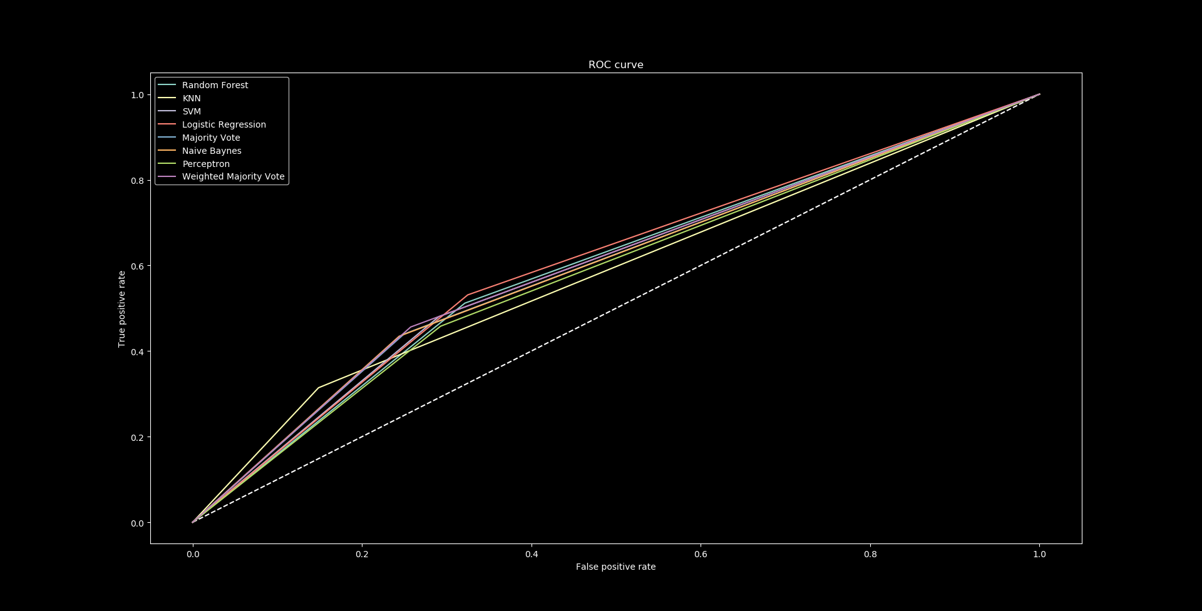

Slide 11
Tuning
#Logitics Tuning Params
C = [ 0.01, 0.1, 1, 10, 100]
#Perceptron Tuning Params
alpha = [0.000001, 0.00001, 0.0001, 0.001, 0.01, 0.1, 1.0, 10, 100, 1000]
#Linear SVM Tunning Params
C = [ 0.01, 0.1, 1, 10, 100]
#Random Forest Tunning Params
n_estimators = [200, 400, 600, 800, 1000, 1200, 1400, 1600, 1800, 2000]}
#KNN Tuning Params
n_neighbors’:k = [1, 3, 5, 11, 21, 41, 61, 81]

Slide 12
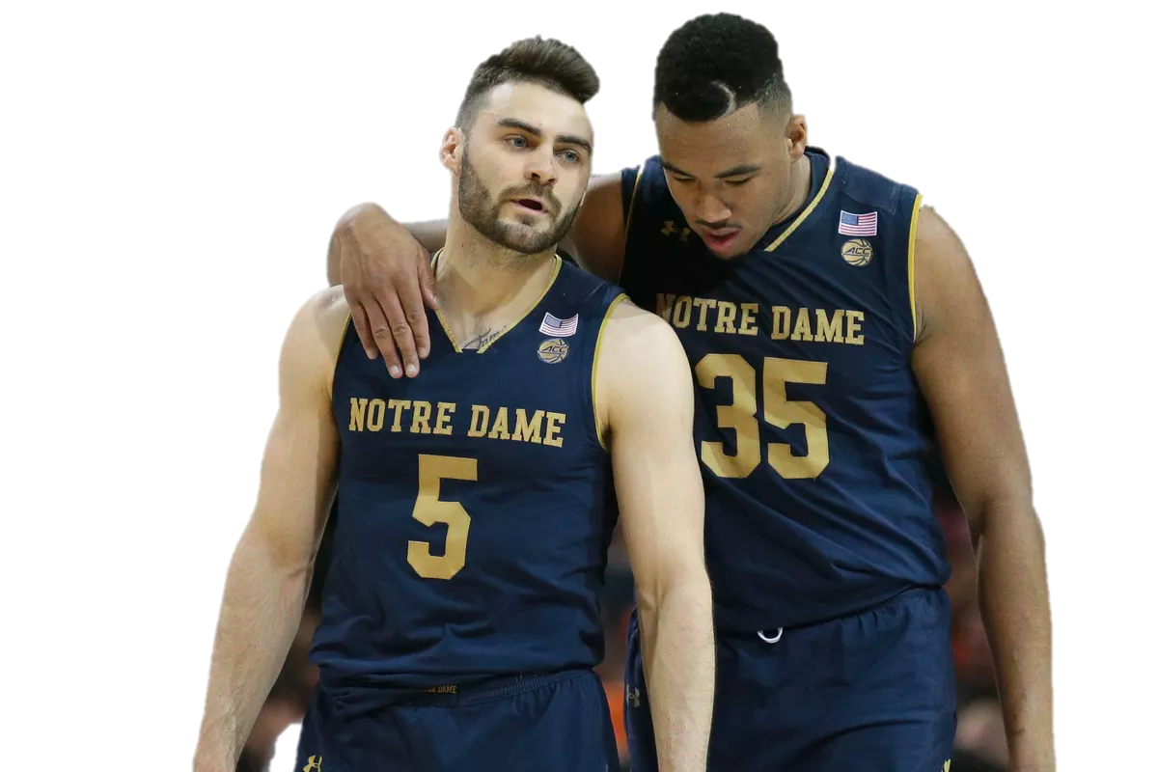
Ensemble
Ensemble all the models we have

Slide 13
Majority Vote
A. Voting Approach
Overall Acc score: 0.7121915969856508
Recall score (Tru Pos Rate): 0.44634036820835205
Precision score: 0.18624695521828744
Neg Predictive Val: 0.7467195427771622
Tru Neg Rate(Specifi): 0.9121607181021586
F1 score: 0.26282390269698575
Auc score: 0.5965299554927571
Unweighted
Weighted
0.7095592030556416 0.4562191288729232
0.187039764359352 0.7467195427771622
0.9121607181021586
0.2653087870479175 0.5993406835826679

Slide 14

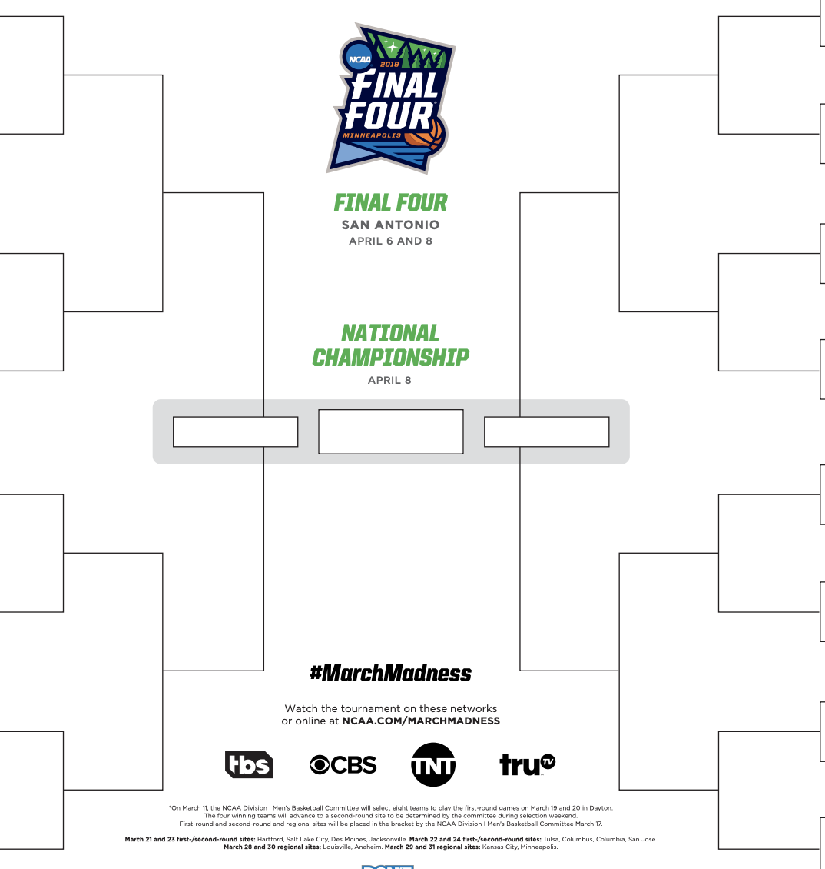

Slide 15
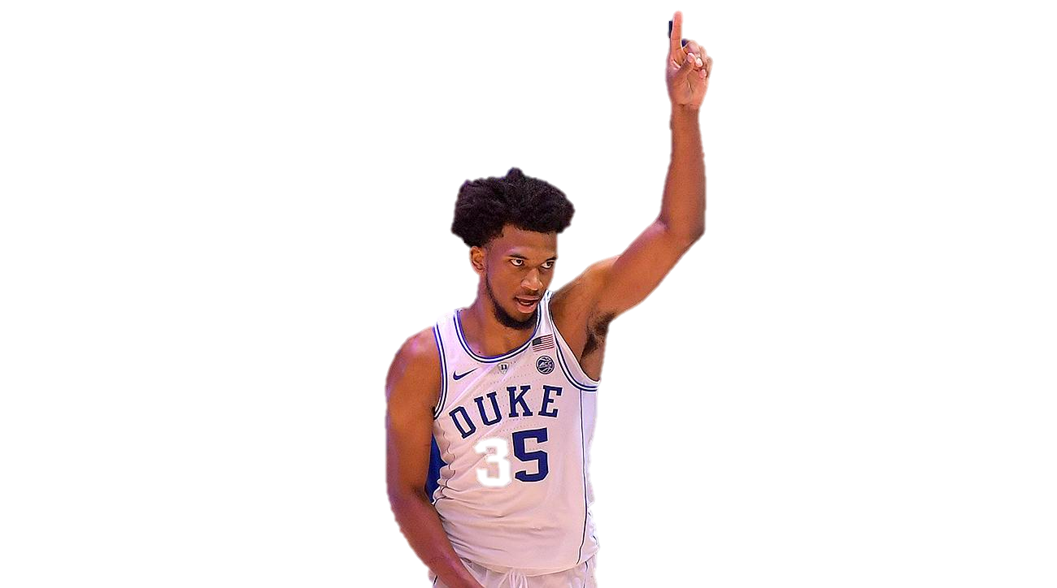
Limitation
1. Lack of domain knowledge about NCAA and basketball.
2. For the modeling, it not a 100% classification problems. When it comes to the difficult data point hard to be separated, which means the probability is closed to .5.
3. More related dataset should be used for this match

Slide 16
thank

